Slide 1
Sales Forecasting
By
Umer Mujawar
Amit Patil
Rushikesh Kate
Laxmi Wandare

Slide 2
Problem Statement – Build a Predictive Model Forecast future sales based on historical Data - Seasonal Trends - Promotional Activities - Other Relevant Factor This can help Businesses Optimize Their Inventory Management and Resource Allocation

Slide 3
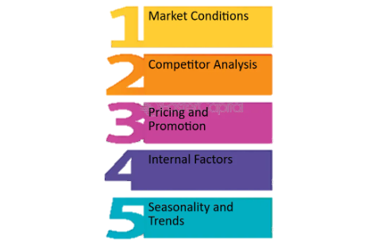
Factor Influencing Sales

Slide 4
What is Different In Us ?
Anyone can use
Generalized
Easy to Use
Any Normal Grocery owner or normal vendor Can Use it
Key Feature – Generalized

Slide 5
Disadvantages
Accuracy
As generalize predictive model it not consider other factors like
- Competitor
- Current Market Situation (Pandemic or other things)
We can only get monthly prediction other option are not available
Past Data Required (last 12 months sales)

Slide 6
Technical Overview -
Dataset –
We use data of 5 yeas
Used feature –
Sales and corresponding months
Preprocessing –
Used sales difference
Training Type and Model Type –
Used Supervised learning Method using linear regression to build generalize sales forecasting

Slide 7
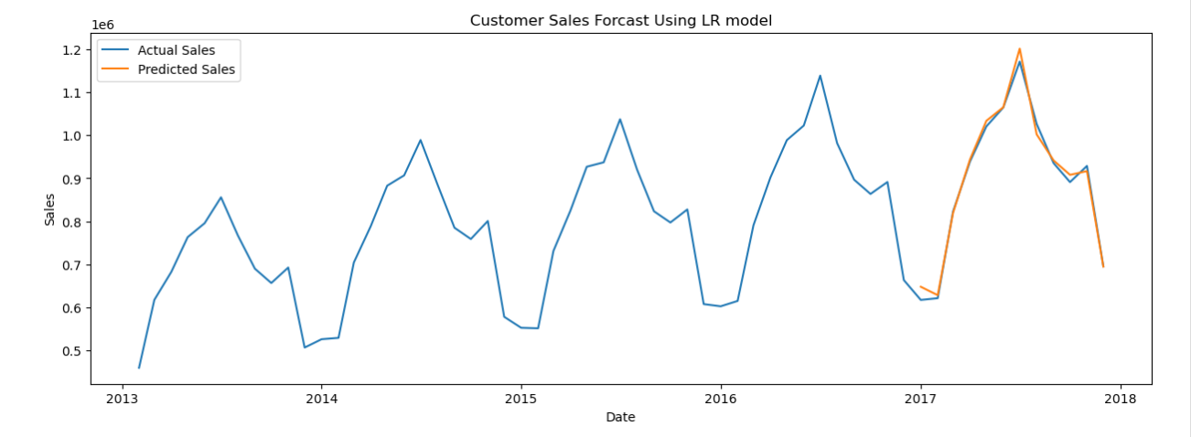

Slide 8
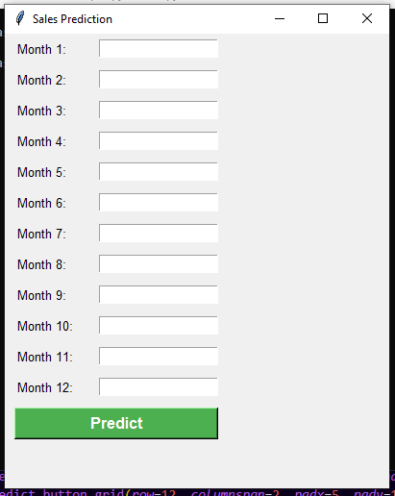
Web Application UI
We used Tkinter Library for Designing the UI
We Used joblib.pickle Library to save Weights of Model

Slide 9
